Slide 1
MACHINE LEARNING (CSE4020)
FINAL REVIEW
-by
RASHI KASERA(17BCE2421)

Slide 2
TYRE DEFECT DETECTION

Slide 3
Abstract
The main objective of our project is to create a system which can detect defects and allow the professionals to spend more time on trying to find a fix for it instead of spending time diagnosing it.
We wish to provide an automated Inspection system that is Reliant and Fast with Improved Business Sustainability at a Lower Cost. Our model will be created using Convolutional Neural networks (CNNS).

Slide 4
Problem Statement
Challenges with Manual Inspection:
Manual Inspection depends on Inspector’s skill
There is a high chance of missing defects
Solution Required:
Automated System in which tire is scanned by an artificial Eye (Camera).
Output will be compared with the defect specifications and judgement will be taken

Slide 5
Existing System
Manual Inspection
The current system is highly skill dependent, and relies on the observation and correct diagnostic being made by the professional.
Each year, about 11,000 tire-related crashes occur. Many of these wrecks results from either tire underinflation or worn-down tread. Experts also estimate that 200 people die annually from weak-tire accidents.

Slide 6
What are we offering?
● Automated Inspection
● Reliant and Faster Solution
● System with Improved Business Sustainability
● Lower Cost
A system which can detect defects and allow the professionals to spend more time on trying to find a fix for it instead of spending time diagnosing

Slide 7
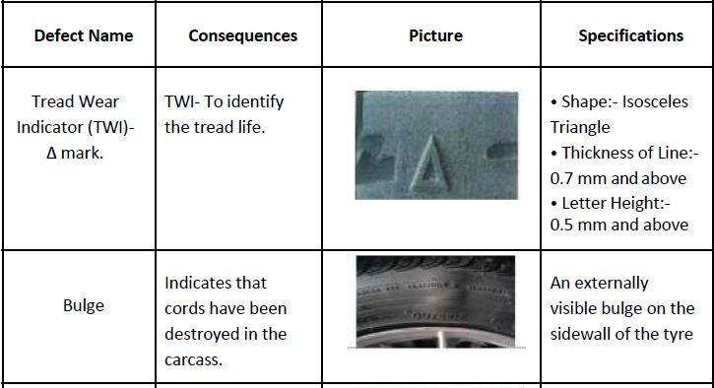
Types of defects

Slide 8
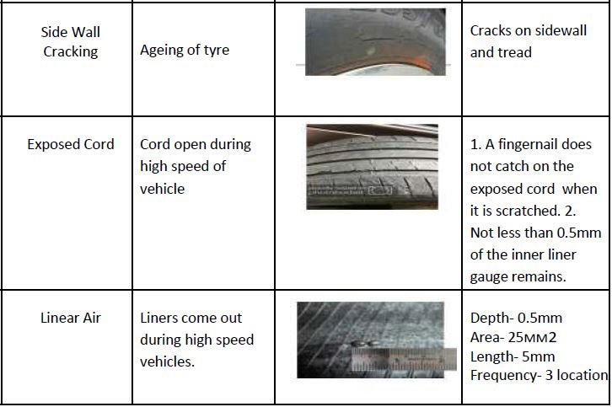

Slide 9
Data Gathering
Since, there are no existing datasets on defective tyre images, a dataset was obtained by collecting images from Google Images and resizing them.
Challenges faced:
● Not enough images available for each defect
● Not correctly classified.
How did we overcome:
● Data Augmentation
● Deletion of unwanted pictures
● Dropout of 0.5 to prevent overfitting

Slide 10
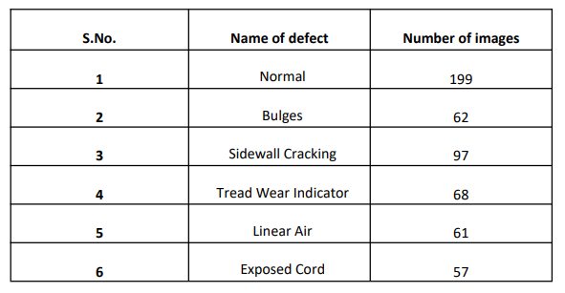
Data Obtained

Slide 11
Multiclass Clasification:
Classification problems having multiple classes with imbalanced dataset is known as multiclass classification. A classification task with more than two classes and where each sample is assigned to one and only one label is known as multiclass classification. An imbalanced dataset is a dataset where the data is not equally distributed among the classes. In this project we have more than one class of tire defects and the number of images in each class is also not equal. Thus we ahve used multiclass classification in the project.

Slide 12
Transfer Learning
Transfer learning is a research problem in machine learning that focuses on storing knowledge gained while solving one problem and applying it to a different but related problem. For example, knowledge gained while learning to recognize cars could apply when trying to recognize trucks. From the practical standpoint, reusing or transferring information from previously learned tasks for the learning of new tasks has the potential to significantly improve the sample efficiency of a reinforcement learning agent.
You can use transfer learning on your own predictive modeling problems.Two common approaches are as follows:
Develop Model Approach
Pre-trained Model Approach
We have used Pre-trained Model Approach

Slide 13
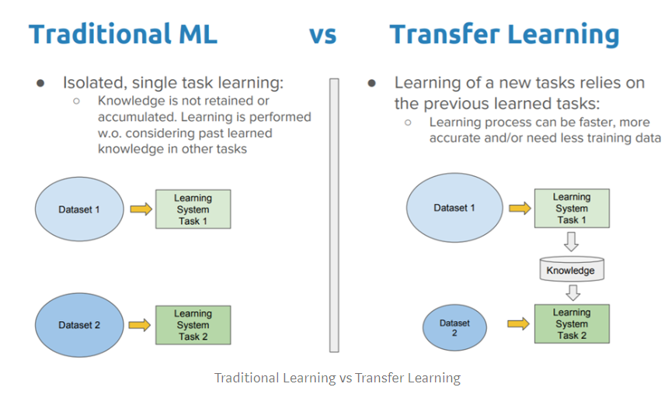

Slide 14
Pre-trained model Approach
Select Source Model. A pre-trained source model is chosen from available models. Many research institutions release models on large and challenging datasets that may be included in the pool of candidate models from which to choose from.
Reuse Model. The model pre-trained model can then be used as the starting point for a model on the second task of interest. This may involve using all or parts of the model, depending on the modeling technique used.
Tune Model. Optionally, the model may need to be adapted or refined on the input-output pair data available for the task of interest.

Slide 15
Why pre-trained model
A pre-trained model like ResNet34 is an already pre-trained model on a huge dataset (ImageNet) with a lot of diverse image categories. Thus the model should have learns a robust hierarchy of features, which are spatial, rotation, and translation invariant with regard to features learned by CNN models. Hence, the model, having learned a good representation of features for over a million images belonging to 1,000 different categories, can act as a good feature extractor for new images suitable for computer vision problems. These new images might never exist in the ImageNet dataset or might be of totally different categories, but the model should still be able to extract relevant features from these images.
This gives us an advantage of using pre-trained models as effective feature extractors for new images, to solve diverse and complex computer vision tasks, with fewer images.

Slide 16
Library used FASTAI
FASTAI-fast, robust, portable, and scalable
-Based on top of PyTorch
-The fastai library allows you to train a Model on a certain DataBunch very easily by binding them together inside a Learner object.
-Provides tools to preprocess and group our data.
The vision module of the fastai library contains all the necessary functions to define a Dataset and train a model for computer vision tasks.
●vision.image
●vision.transform
●vision.data
●vision.learner

Slide 17
Architecture used
ResNet:
In deep learning having a lot of hidden layers paves way to the vanishing / exploding gradients problem which actually makes the neural network unusable. ResNet takes care of the maximum learning of weights possible without over- fitting or negative deviation of accuracy through means of vanishing or exploding gradients problem. One does not have to worry about the number of hidden layers that should be used for the neural network architecture.
For our mode, we have used a pretrained model of Resnet 34 trained on ImageNet and have adapted it to our dataset. This was done to have a model that has already been trained to recognize a few features.

Slide 18
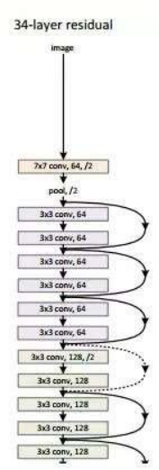

Slide 19
CNN
In neural networks, Convolutional neural network (ConvNets or CNNs) is one of the main categories to do images recognition, images classifications. Objects detections, recognition faces etc., are some of the areas where CNNs are widely used. CNN image classifications take an input image, process it and classify it under certain categories. Computers see an input image as an array of pixels and it depends on the image resolution. Based on the image resolution, it will see h x w x d. Technically, deep learning CNN models to train and test, each input image will pass it through a series of convolution layers with filters (Kernels), Pooling, fully connected layers (FC) and apply Softmax function to classify an object with probabilistic values between 0 and 1.

Slide 20
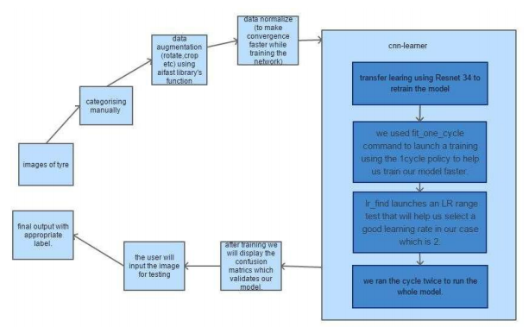
Flowchart

Slide 21
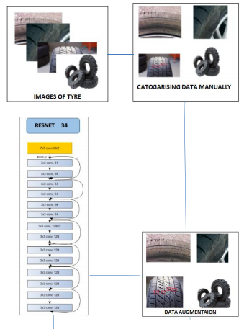
Architecture Diagram

Slide 22
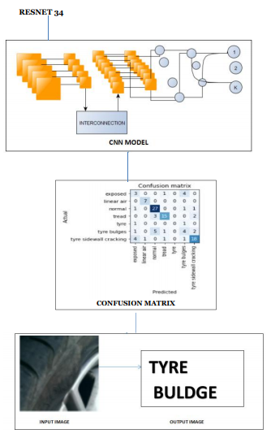

Slide 23
Pseudocode:
import fastai vision // the fastai library of pytorch
path = (set path location)
drive.mount(‘gdrive’, force_remount=True)
directory path=(set path )
{
classes = ['exposed','linear air','normal','tread','tyre buldges','tyre sidewallcracking']
for c in classes
print (c)
verify_images(path) // verify the image(data) present in folders mentioned
data= imageDataBunch, from_folder(path) // loading the folder data in variable.

Slide 24
learn=cnn_learner(data, models.resnet34, metrics=error_rate)
{
// cnn_learner used to classify image data and uses architecture resnet 34 .
//other parameter, error rate matrix is also generated
learn.fit_one_cycle(5) // launch a training using 1 cycle policy to train model faster
learn.save() //to save the model using predefined save method
learn.unfreeze() // unfreeze the other layer and train the complete network
learn.lr_find // find the learning rate with minimum loss.
learn.recorder.plot() //rating learning rate with loss
learn.fit_one_cycle(4) // launch a training using 1 cycle policy to train model faster in a
particular range

Slide 25
learn.save()
learn.load() //remembers the classes, the transforms you used or the
normalization in the data, the model, its weight. test image= path
learn=load_learner(path)
pred_class(test image) // to predict the defect
}
}

Slide 26
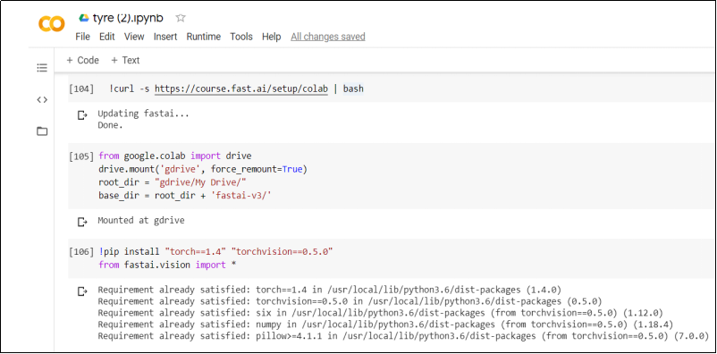
Code

Slide 27
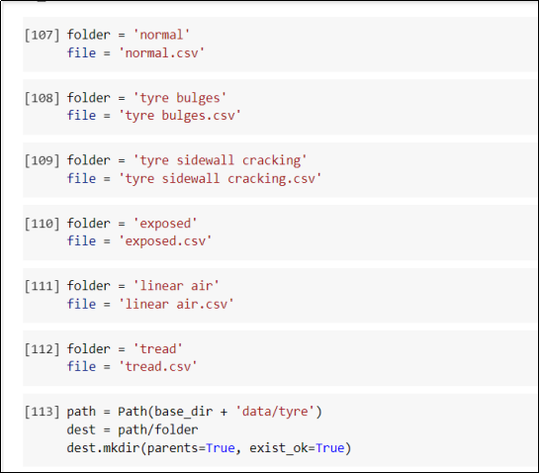
Exploring Data

Slide 28
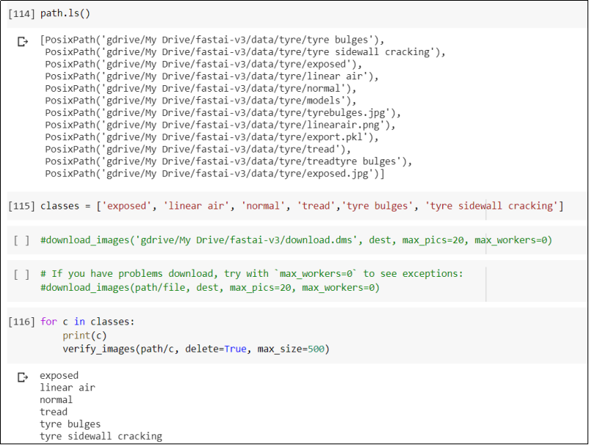

Slide 29
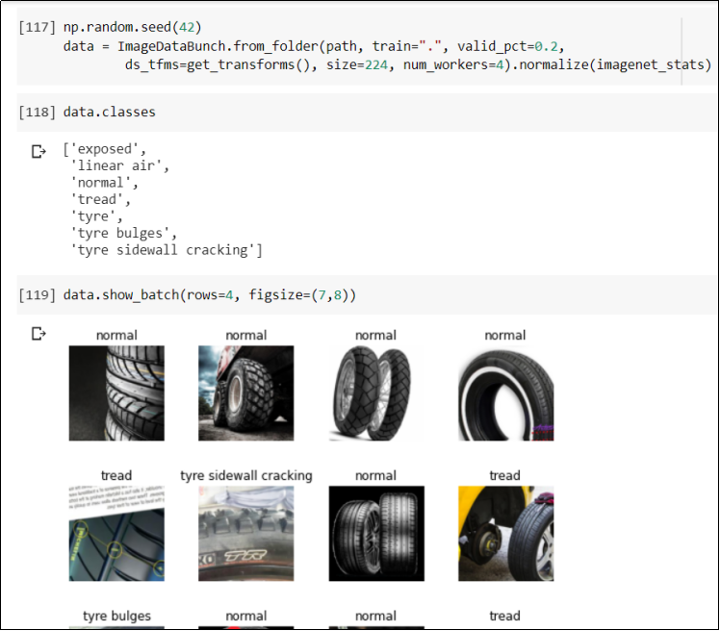

Slide 30
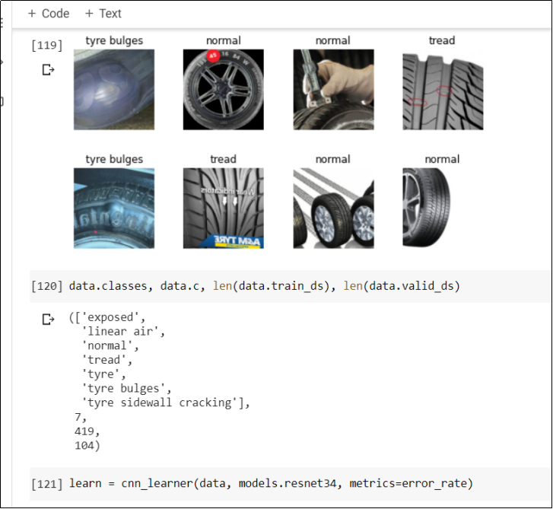
Training the Model

Slide 31
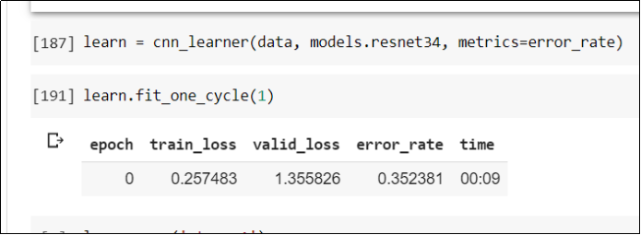
Experiment
1 epoch:

Slide 32
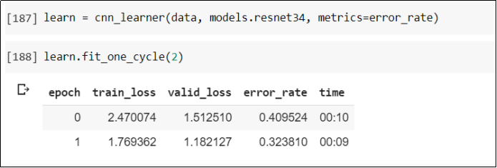
2 epochs:

Slide 33
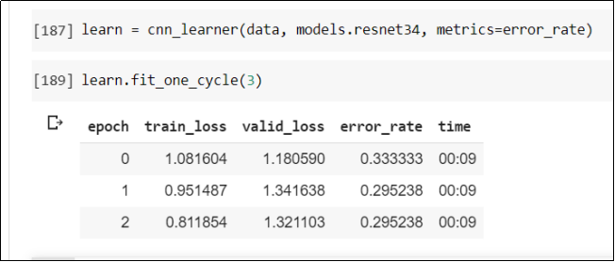
3 epochs:

Slide 34
4 epochs:

Slide 35
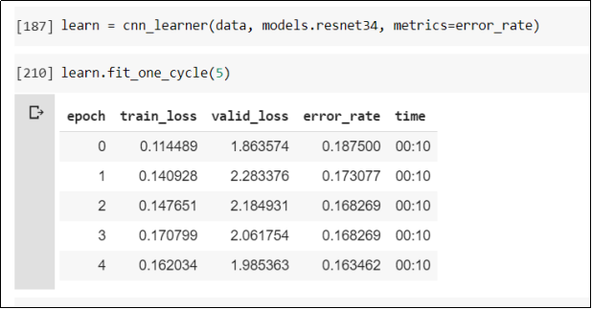
5 epochs:

Slide 36
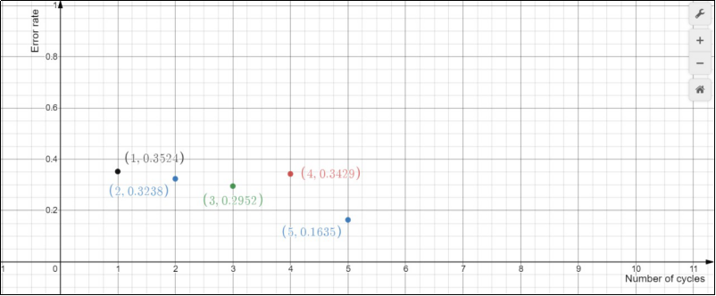
Graph (Error rate vs No. of epochs)

Slide 37
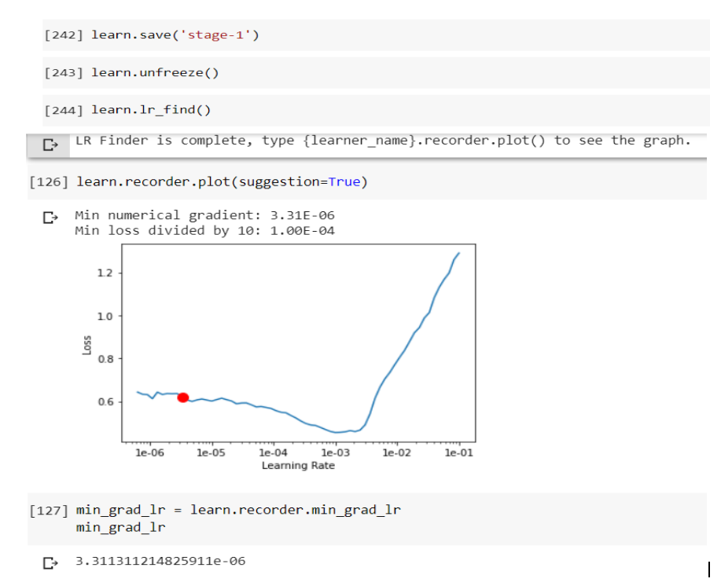

Slide 38
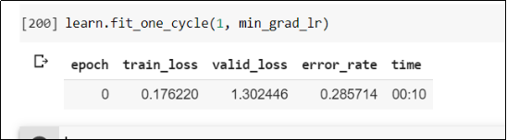
After finding the learning rate, number of cycles has been altered to check which one gives the minimum error rate
1 epoch:

Slide 39
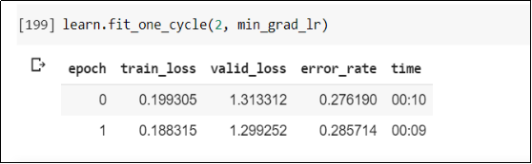
2 epochs:

Slide 40
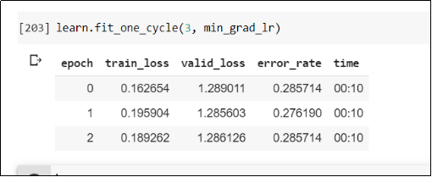
3 epochs:

Slide 41
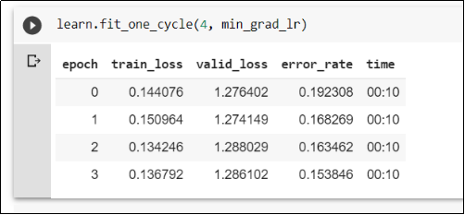
4 epochs:

Slide 42
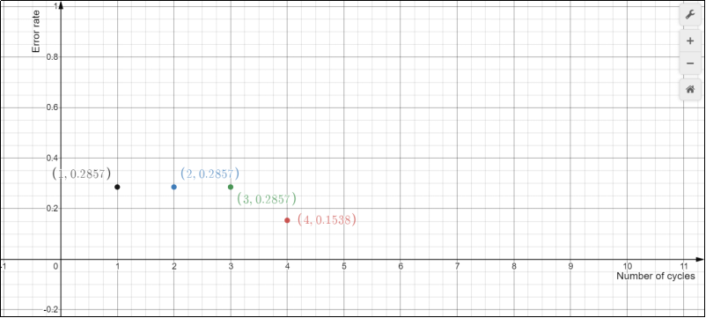
Graph (Error rate vs No. of epochs)

Slide 43
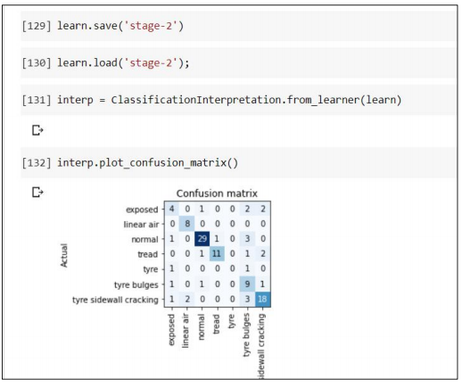
Confusion Matrix

Slide 44
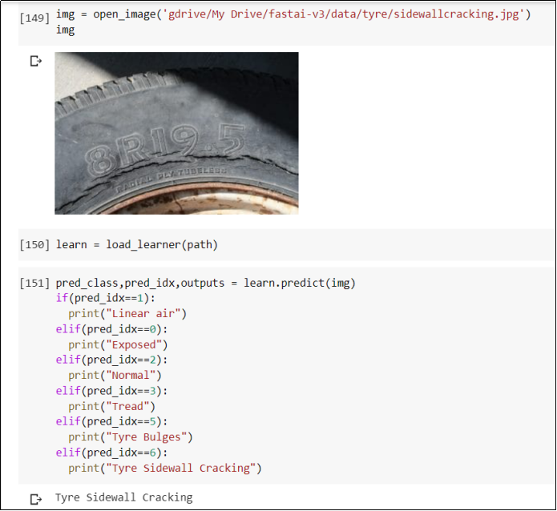
Output

Slide 45
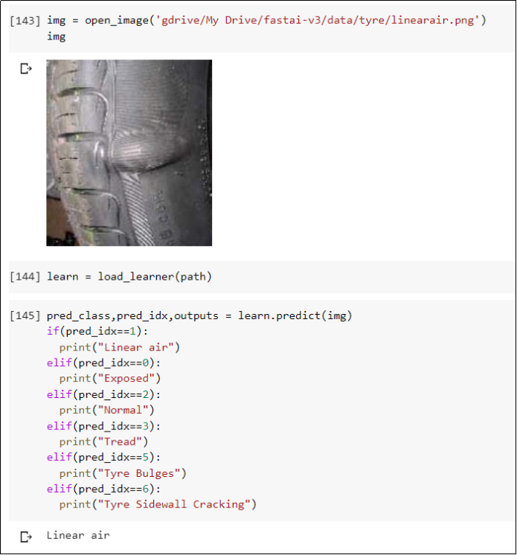

Slide 46
Result
By taking the average of 4 epochs and learning rate of 3.113 e-06 , the model can predict the tyre defect with the accuracy of 83.05%. The model can detect the tyre defects from the objects mentioned in class and can classify them as exposed, linear air, tread, tyre bulges, normal and tyre sidewall cracking. Fast ai vision library is used to make the prediction fast. Cnn_learner that is built in fastai function, has been used to load the CNN architecture. Specifically, Resnet 34 model has been trained. The process is explained with the help of flow chart and architecture diagram and the defects have been detected

Slide 47
Conclusion
In this work. We propose a unified tyre defect detection system to find the defects such as Tread Wear Indicator ,Bulges,Sidewall Cracking,Linear Air and Exposed Cord. Pre-trained models are used to save computation time and resources.Fats Ai library allows us to train models on certain DataBunch very easily.Finally, Resnet reserves the gradient that leads to better results.. Up to now, defect detection method has achieved the result for the the five types of defects.Our next goal is to include more images in our data set to get the accurate results.

Slide 48
THANK YOU

